Slide 1

CUSTOMER INTELLIGENCE FOR RETAIL CHAIN
Segmentation & Market Basket Analysis
Dataset: UCI Online Retail II Dataset:
CS4237: DATA MINING & WAREHOUSING
BY: AMA BADUWA BAIDOO
Notes:
Good morning/afternoon. Today I'll present my data mining project for a retail chain, focusing on customer segmentation using K-Means clustering and product association analysis using market basket techniques. I used the UCI Online Retail II dataset containing over 525,000 transactions.

Slide 2
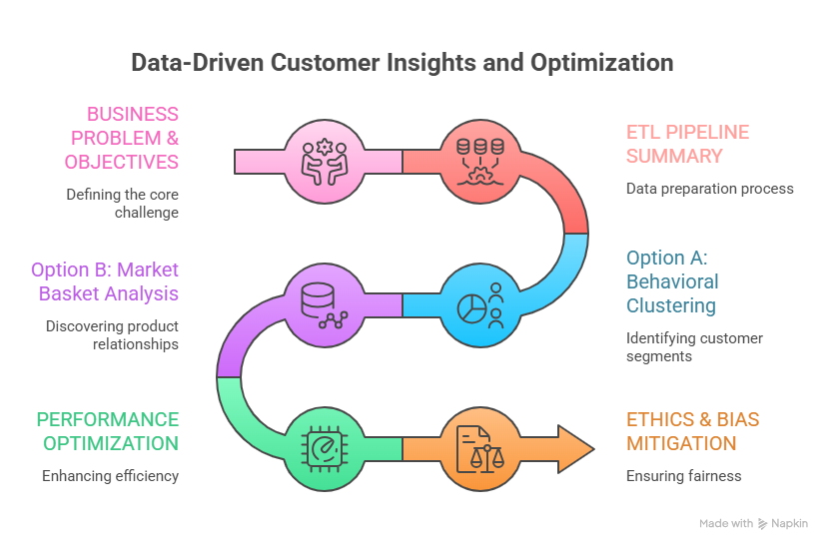
TABLE OF CONTENT

Slide 3
BUSINESS PROBLEM & OBJECTIVES
BUSINESS CONTEXT
Fast-moving retail chain in UK
Wants to harness data to understand customers
Optimize inventory and drive sales
TWO BUSINESS QUESTIONS
QUESTION 1: Customer Segmentation | QUESTION 2: Product Association
"Which customer segments generate highest value and what behaviors define them?" | "What product combinations are frequently purchased together?"
Approach: K-Means ClusteringFeatures: RFM (Recency, Frequency, Monetary) | Approach: Association Rule MiningMetrics: Support, Confidence,Lift
Notes:
The retail chain wants to answer two key questions. First, which customer segments generate the highest value? I approached this with K-Means clustering using RFM features. Second, what products are frequently bought together? I used association rule mining with support, confidence, and lift metrics."

Slide 4
ETL PIPELINE SUMMARY
EXTRACTION (FULL)
TRANSFORMATION
Missing Values: 20.54% CustomerID → Preserved with flagging Date Standardization: YYYY-MM-DD De-duplication: 6,865 exact dupes Removed: 3,672 invalid prices Removed: 10,098 cancelled invoices
525,461 rows ~5 minutes Daily updates
FINAL DATASET
498,359 rows (94.8% preserved)
4,312 verified customers
£22,084,220.58 total sales
LOADING
UPSERT METHOD UPDATE + INSERT Preserves IDs Idempotent
Notes:
For ETL, I used full extraction given the manageable data volume. For missing CustomerIDs at 20.5%, I chose to preserve and flag rather than delete - this saved over 100,000 transactions. Date standardization enabled time-series analysis. The UPSERT loading method ensures customer IDs remain consistent across daily updates

Slide 5
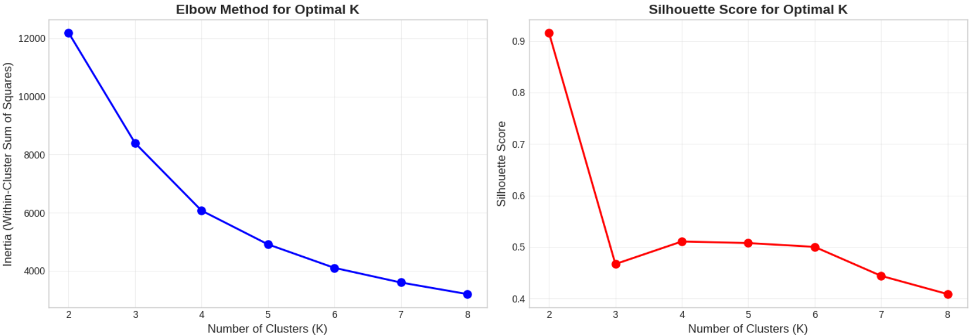
K-MEANS: OPTIMAL K SELECTION
A
OPTIMAL K = 4
Elbow point at K=4 (diminishing returns beyond)
Highest silhouette score at K=4 (0.511)
Notes:
To determine the optimal number of clusters, I used both the elbow method and silhouette scores. The elbow method shows diminishing returns after K=4, and the silhouette score peaks at K=4 with 0.511. This indicates good separation between clusters. Therefore, I selected 4 customer segments."

Slide 6
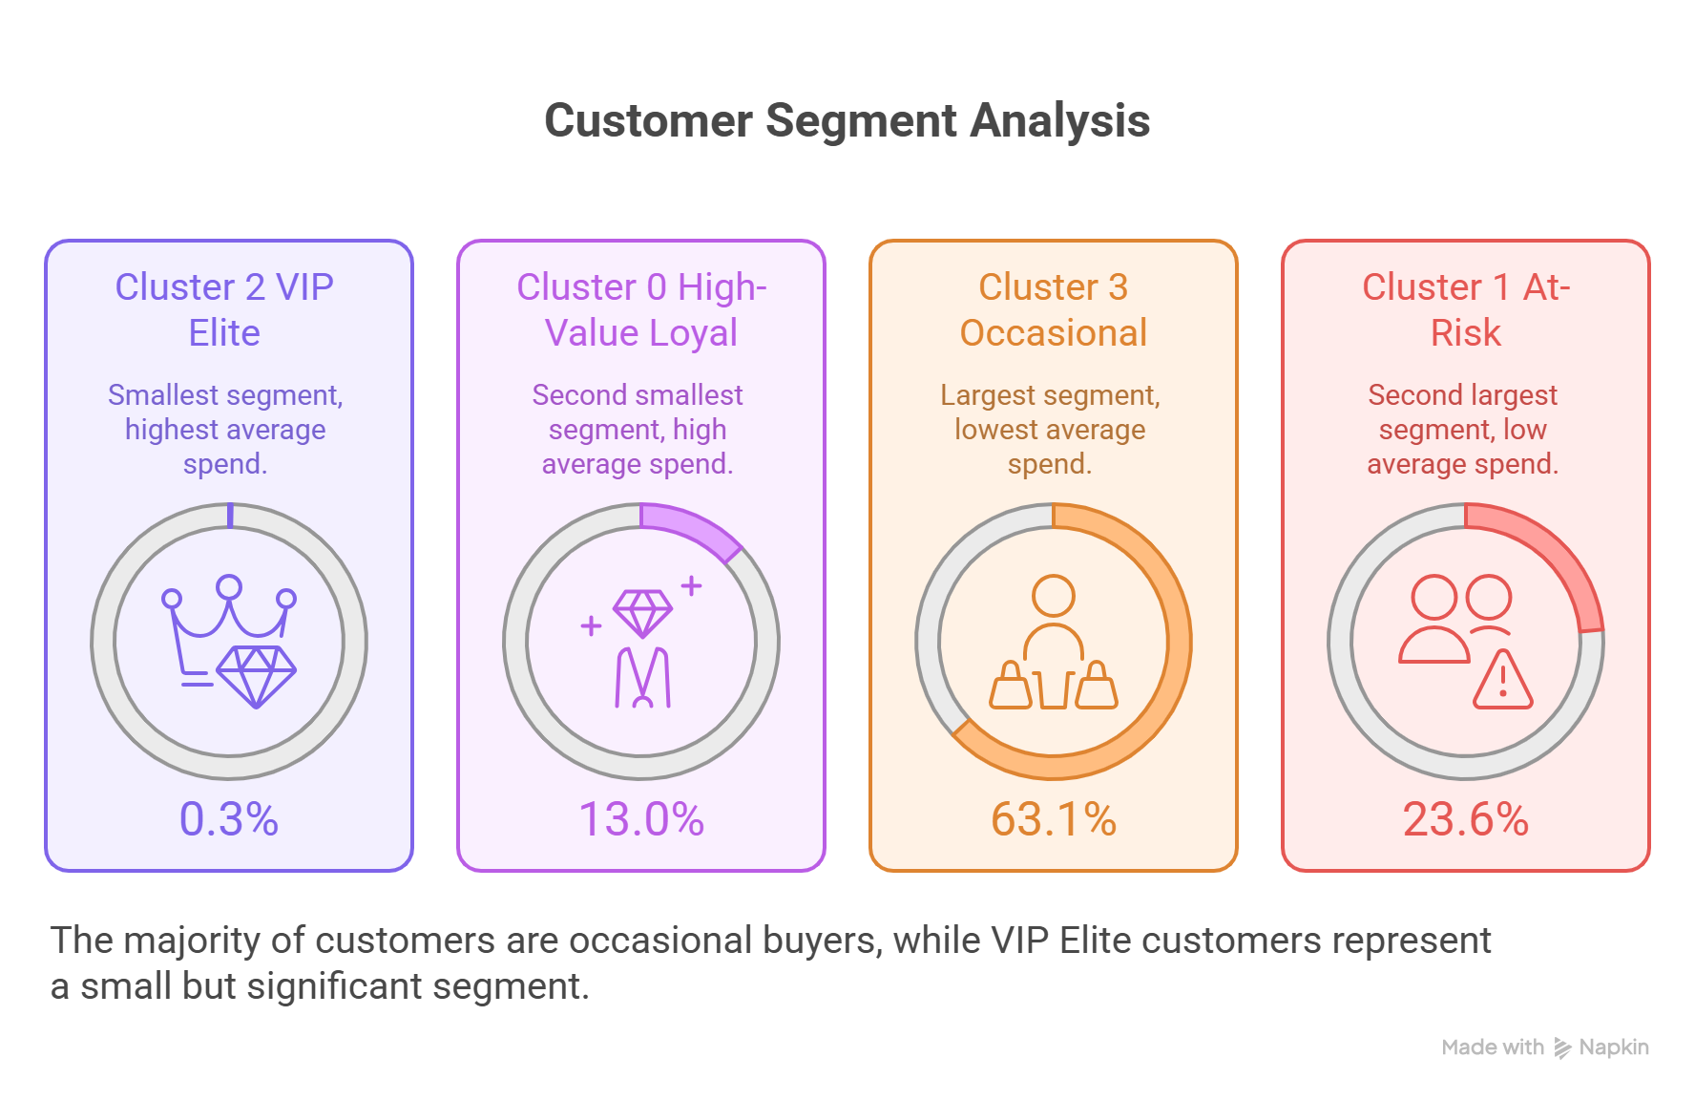
4 CUSTOMER SEGMENTS IDENTIFIED
A
£116,368 AVG SPEND
3 DAYS RECENCY
ELITE CONCIERGE
£6,502 AVG SPEND
24 DAYS RECENCY
VIP RETENTION
£1,166 AVG SPEND
46 DAYS RECENCY
GROWTH OPTIMIZATION
£573 AVG SPEND
245 DAYS RECENCY
WIN-BACK CAMPAIGN
Notes:
Here are the 4 customer segments I discovered. The VIP Elite - only 0.3% of customers but spend £116,000 on average with 115 transactions. The High-Value Loyal segment - 13% of customers, spending £6,500. The Occasional Buyers - 63% of customers, representing growth opportunity. And the At-Risk segment - 24% who haven't purchased in 245 days on average, needing win-back campaigns. Each segment has a tailored strategy.

Slide 7
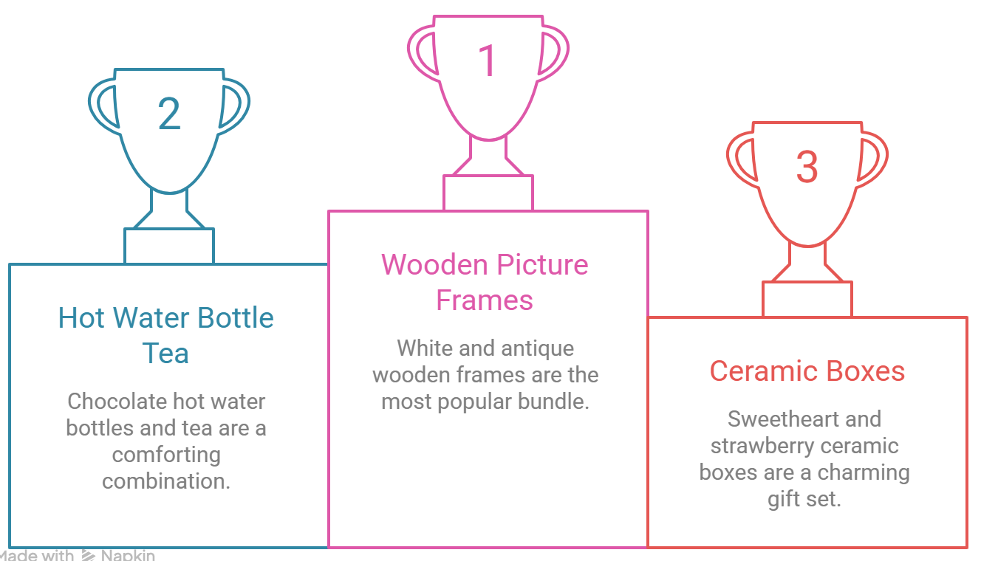
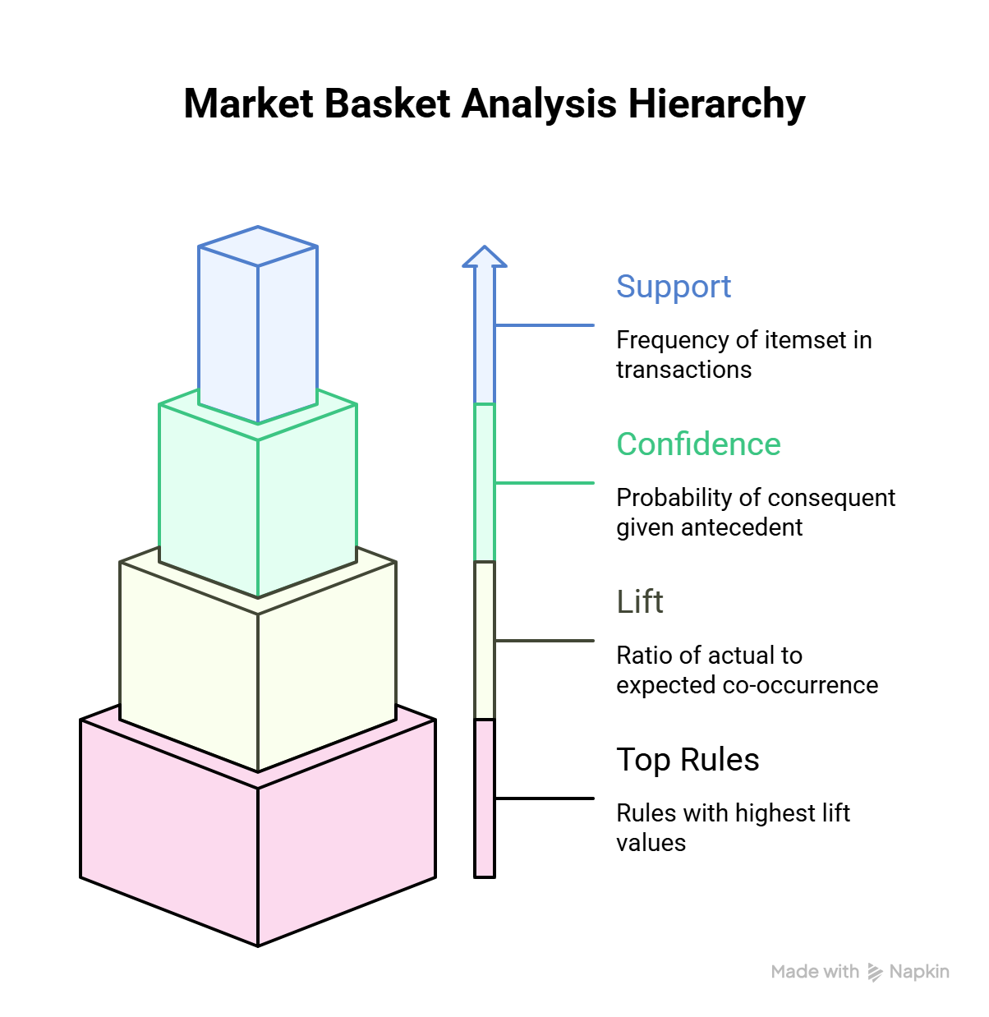
MARKET BASKET ANALYSIS: TOP RULES
TOP PRODUCT BUNDLES BY LIFT
B
Notes:
For market basket analysis, I discovered 308 association rules. The strongest is wooden picture frames - customers who buy one style are 10 times more likely to buy the matching frame. The ceramic trinket boxes show 79% confidence - very reliable for cross-selling. All 308 rules have lift above 1, with 100 rules showing strong complementarity with lift above 2.

Slide 8
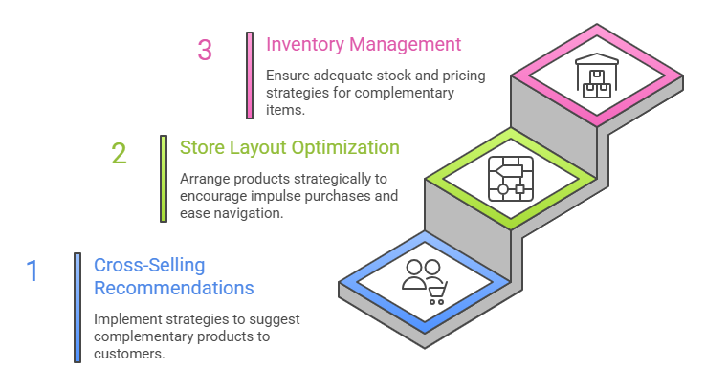
STRATEGIC SALES ENHANCEMENT
B

Slide 9
PERFORMANCE OPTIMIZATION
PROBLEM: 3 seconds → 20 minutes at 500M rows
EXPECTED: 20 minutes → 3-5 seconds
SOLUTION 1: INDEXING
B-tree indexes on CustomerID, InvoiceDate
O(n) scans → O(log n) lookups
SOLUTION 2: MATERIALIZED VIEWS
Pre-computed daily/monthly aggregates
500M rows → 500K rows for common queries
Notes:
Beyond programmability, networks are becoming automated. Instead of typing commands on each device, operators declare high-level intents—like 'provide low-latency path for video traffic'—and the network configures itself. This is Intent-Based Networking, and it's transforming how large-scale networks are managed.

Slide 10
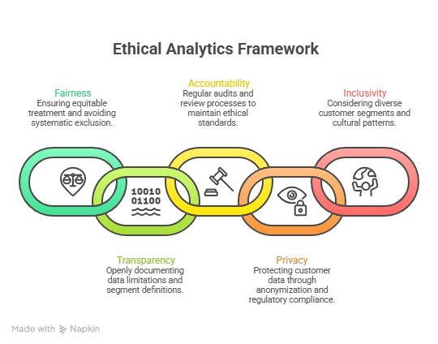
ETHICS & BIAS MITIGATION
IDENTIFIED BIAS | MITIGATION
UK-centric (92.4% data) | International segment analysis
20.5% missing CustomerID | Flagged, not deleted
Spend-based segmentation | Add seasonal & category features
Notes:
For scaling to 500 million rows, indexing reduces O(n) scans to O(log n) lookups, and materialized views pre-compute aggregates. For ethics, I identified three biases: UK-centric data, missing CustomerIDs, and spend-based segmentation. My mitigations include flagging missing data, adding seasonal features, and planning international analysis.

Slide 11
BUSINESS IMPACT & CONCLUSION
4 customer segments identified 308 product association rules discovered ETL pipeline with 94.8% data preservation Scalable architecture for 500M+ rows
KEY DELIVERABLES
📈 Marketing ROI: +15-25% (targeted segment campaigns) 🛒 Basket value: +10-15% (cross-selling recommendations) 💰 Total sales: £22M (498,359 clean transactions)
EXPECTED BUSINESS VALUE
Notes:
In conclusion, I delivered 4 customer segments, 308 product association rules, and a robust ETL pipeline. Expected business impact includes 15-25% increase in marketing ROI and 10-15% increase in basket value. Next steps include A/B testing campaigns and implementing a real-time recommendation engine. Thank you - I'm happy to take questions.

